Slide 1
Module2: Introduction to Scripting Javascript
JavaScript - Introduction, Operators - Control Statements - Functions, Dialog boxes - Arrays - Objects - Document Object Model - JavaScript Event Handling, Form Processing

Slide 2
Introduction
JavaScript (JS) is the programming language of the Web. It is used to program the behavior of web pages
JavaScript is a lightweight, interpreted programming language.
Applications
Client Side Validation
Manipulating HTML pages (Dynamic drop-down menus)
User Notifications
Back End Data Loading
Presentations
Server Applications
JavaScript implementations allow client-side script to interact with the user and make dynamic pages.
Client Side JS:
The script should be included in or referenced by an HTML document for the code to be interpreted by the browser.

Slide 3
Introduction to JavaScript
JavaScript is the most popular scripting language on the internet and works in all major browsers such as IE, Firefox, Chrome, Opera and Safari.
JavaScript is used in billions of Web pages to add functionality, validate forms, communicate with the server and much more.
The client-side environment used to run scripts is usually a browser.
The processing takes place on the end users computer.
The source code is transferred from the web server to the users computer over the internet and run directly in the browser.

Slide 4
Need of JavaScript
JavaScript was designed to add interactivity to HTML pages
JavaScript is a Scripting language.
A scripting language is a light weight programming language
JavaScript is usually embedded directly into HTML pages
JavaScript is an interpreted language (means that scripts execute without preliminary compilation)
Everyone can use JavaScript without purchasing a license

Slide 5
Merits
JavaScript gives HTML designers a programming tool - HTML authors are normally not programmers, but JavaScript is a Scripting language with a very simple syntax.
JavaScript can react to events - A JavaScript can be set to execute when something happens, like when a page has finished loading or when a user clicks on the HTML element.
JavaScript can read and write HTML elements - A JavaScript can read and change the content of an HTML element.
JavaScript can be used to validate data - A JavaScript can be used to validate form data before it is submitted to a server. This saves the server from extra processing.
JavaScript can be used to detect the visitor's browser - A JavaScript can be used to detect the visitor's browser and depending on the browser - load another page specifically designed for that browser.
JavaScript can be used to create cookies - A JavaScript can be used to store and
retrieve information on the visitor's computer.

Slide 6
History
JavaScript was invented by Brendan Eich at Netscape (with Navigator 2.0) and has appeared in all browsers since 1996.
The official standardization was adopted by the ECMA organization in 1997
ECMA-262 is the official JavaScript standard

Slide 7
Pros & Cons
Advantages
Speed and Simplicity
Asynchronous Programming
Less server interaction
Immediate feedback to the visitors
Increased interactivity
Richer interfaces
Reduces Server Load
Disadvantages
Client-Side Security Risk
Code Visibility
Different Interpretation Across Browsers
Single Inheritance
Issues with Debugging
Time-Consuming, especially with low network
Disabling JavaScript can hinder a web page

Slide 8
Syntax
JavaScript can be implemented using JavaScript statements that are placed within the <script>... </script> HTML tags in a web page.
It is normally recommended to keep it within the <head> tags
The <script> tag alerts the browser program to start interpreting all the text between these tags as a script
The script tag takes two important attributes −
Language - specifies what scripting language you are using.
Type - It specifies the media type of the script.
Src – Used when script has to be included as external file
The script tag can be used within <body> or <head> tag to embed the scripting code.
HTML script tag is used
to embed script code
to link script file
<script language = "javascript" type = "text/javascript">
document.write("Hello World!")
</script>

Slide 9
JavaScript ignores spaces, tabs, and newlines that appear in JavaScript programs
Semicolons are Optional
JavaScript is a case-sensitive language.
Comments
Any text between a // and the end of a line is treated as a comment and is ignored by JavaScript. <!– is a single line comment like ‘//’
Any text between the characters /* and */ is treated as a comment
Warning for Non-JavaScript Browsers
Add a noscript block immediately after the script block
We can include JavaScript code anywhere in an HTML document
Script in <head>...</head> section.
Script in <body>...</body> section.
Script in <body>...</body> and <head>...</head> sections.
Script in an external file and then include in <head>...</head> section.

Slide 10
External Javascript
It is an attempt to reuse identical JavaScript code on multiple pages of a site.
The script tag provides a mechanism to allow you to store JavaScript in an external file and then include it into your HTML files.
<script type = "text/javascript" src = "filename.js" ></script>
To use JavaScript from an external file source, you need to write all your JavaScript source code in a simple text file with the extension ".js" and then include that file as shown above.

Slide 11
Sample Javascript Code
<html>
<body>
<p>
hello world</p>
<script>
document.write(“Hello VIT!");
</script>
</body>
</html>

Slide 12
Operators
JavaScript supports the following types of operators.
Arithmetic Operators (+.-,*,/, %,++,--)
Comparison Operators (==,!=,>,<,>=,<=)
Logical (or Relational) Operators (&&, ||, !)
Bitwise Operators (&, |, ^,~,<<,>>, >>>,
Assignment Operators (=,+=,-=,*=,/=,%=)
Miscellaneous Operators
Conditional (or ternary) Operators (?:)
typeof Operator

Slide 13
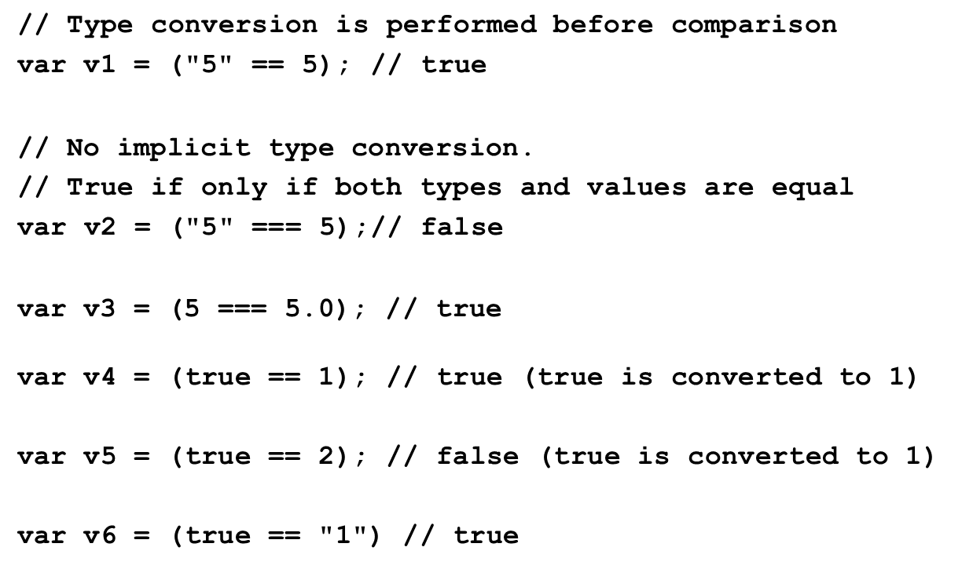
== vs ===

Slide 14
Variables
A JavaScript variable is simply a name of storage location. There are two types of variables in JavaScript : local variable and global variable.
Rules for declaring:
Name must start with a letter (a to z or A to Z), underscore( _ ), or dollar( $ ) sign.(Ex. Variable name ‘123college’ is invalid, _123college is valid)
After first letter we can use digits (0 to 9), for example value1.
JavaScript variables are case sensitive, for example x and X are different variables.
Var a= 10;//hold number
Var b=“VLR”; //hold string
Variables are declared using ‘var’

Slide 15
Variables
Local Variables | Global Variables
A JavaScript local variable is declared inside block or function. It is accessible within the function or block only | A variable i.e. declared outside the function or declared with window object is known as global variable.
<script> function abc(){ var x=10;//local variable } </script> | <script> var data=200;//global variable function a(){ document.writeln(data); } </script>

Slide 16
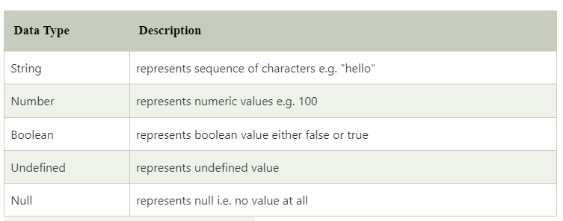
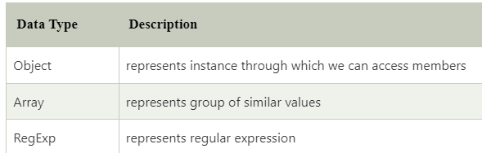
Datatypes
JavaScript is a dynamic type language, means you don't need to specify type of the variable because it is dynamically used by JavaScript engine
JavaScript provides different data types to hold different types of values. There are two types of data types in JavaScript.
Primitive Data Type | Non Primitive Data Type

Slide 17
Primitive data type
Numbers - A number can be either an integer or a decimal
Strings - A string is a sequence of letters or numbers enclosed in single or double quotes
Boolean - True or False
Undefined - A variable without a value, has the value undefined.
Null - In JavaScript null is "nothing".
In JavaScript, the data type of null is an object.

Slide 18
Difference Between Undefined and Null
Undefined and null are equal in value but different in type:
typeof undefined typeof null
// undefined
// object
null === undefined null == undefined
// false
// true

Slide 19
Non Primitive data type
Object
Unordered collection of properties
Name:value pairs
var student={name:”Arun”,regno:”21BIT001” ,cgpa:9.2};
a = student.regno (or) a= student[“regno”]
Arrays
Collection of values in a single variable
var fruits = [ “apple”,”orange”,”mango”] or var num=[1,2,3]
Dynamic data types – same variable can be used for different types
var x=5;
var x=“Hai”;

Slide 20
Popup boxes – Alert
An alert box is often used if you want to make sure information comes through to the user.
When an alert box pops up, the user will have to click "OK" to proceed.
<script>
alert(“Good Morning!")
</script>

Slide 21
Popup boxes – Prompt
A prompt box is often used if you want the user to input a value before entering a page.
The user will have to click either "OK" or "Cancel“ after entering an input value.
"OK“ - returns the input value.
"Cancel“ - returns null.
<script>
x=prompt (“Enter ur name”, “ ”)
alert(“Good Morning “+x)
</script>

Slide 22
Popup boxes – Confirm
A confirm box is often used if you want the user to verify or accept something.
The user will have to click either "OK" or "Cancel“.
If the user clicks "OK", the box returns true. If the user clicks "Cancel", the box returns false.
<script>
x=confirm (“Are you sure you want to delete ?”)
</script>

Slide 23
Control Structures
Branching
If statement
If…else statement
If ….else if statement
Switch
Looping
For
For In
For Of
While
Do while

Slide 24
If ...
name = “Maximus”
if (name == “Maximus”) { alert(“Welcome”); }
If (condition)
{
Statements;
}

Slide 25
If ... Else...
if (age<18) { alert(“Not eligible to vote“); } else { alert(“eligible to vote“); }
If (condition)
{
Statements;
}
Else
{
Statement;
}

Slide 26
If ... ElseIf…Else
if (time<12) { alert(“Good morning“); } else if (time<16) { alert("Good afternoon“); }
else if (time <20)
{
alert(“Good Evening”);
} else { alert(“Good night”); }
If (condition)
{
Statements;
}
Else if(condition)
{
Statement;
}
else
{
Statement;
}

Slide 27
Switch
var num;
num=Prompt(“Enter a number (1-9)“); switch (num) { case 1: alert(“Number is one!“); break; case 2: alert(“Number is two!“); break; case 3: alert(“Number is three!“); break; default: alert “Number is greater than 3!"; }
switch (n) { case label1: code to be executed if n=label1; break; case label2: code to be executed if n=label2; break; default: code to be executed
if n is different from both label1 and label2; }

Slide 28
While Loops
While (condition)
{
Statements;
}
while (i<5) { alert("The number is " + i); i++; }

Slide 29
Do While Loops
Do
{
Statements;
} While (condition);
do { alert("The number is " + i ); i++; } while (i<5);

Slide 30
for
for (initialization; condition; increment)
{
code to be executed;
}
for (var i=0; i<5; i++) { alert("The number is " + i ); }

Slide 31
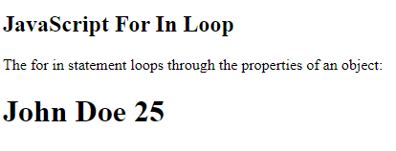
For In Loop
The JavaScript for in statement loops through the properties of an Object:
<html>
<body>
<h2>JavaScript For In Loop</h2>
<p>The for in statement loops through the properties of an object:</p>
<script>
const person = {fname:"John", lname:"Doe", age:25};
let txt = "";
for (let x in person)
{
txt += person[x] + " ";
}
document.write("<h1>" +txt+ "</h1>");
</script>
</body>
</html>
for (key in object) {
// code block to be executed
}

Slide 32
For of loop
The JavaScript for of statement loops through the values of an iterable object.
It lets you loop over iterable data structures such as Arrays, strings,
etc.,
for (variable of iterable) {
// code block to be executed
}

Slide 33
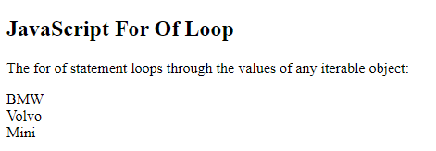
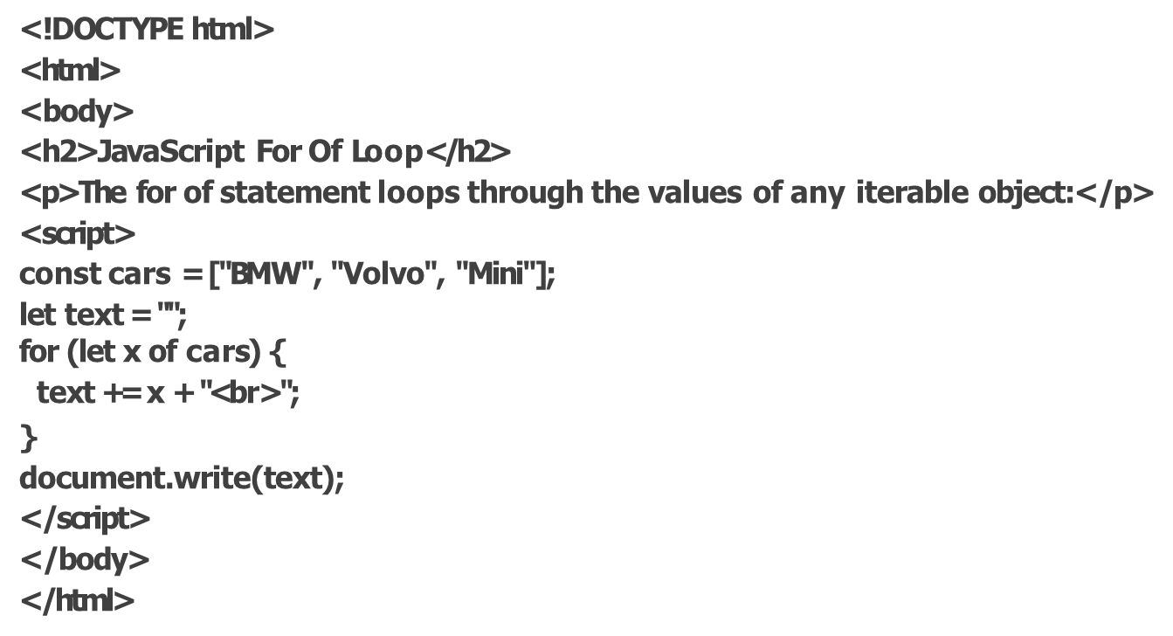
For of loop Demo

Slide 34
JavaScript break and continue
The break statement "jumps out" of a loop.
The continue statement "jumps over" one iteration in the loop.
Example
for (let i = 0; i < 10; i++) {
if (i === 3) { break; }
text += "The number is " + i + "<br>";
}
for (let i = 0; i < 10; i++) { if (i === 3) { continue; }
text += "The number is " + i + "<br>";
}

Slide 35
Arrays
Collection of multiple values in a single variable
Values can be added dynamically
var colors=[“blue”,”yellow”,”green”];
Colors[0] is blue
Colors [2] is green
Length of this array is 3 (colors.length)
Colors[5]=“pink”;
Colors[3] and colors[4] will be undefined
Length of this array is 6

Slide 36
Array Declaration
const cars = ["Saab", "Volvo", "BMW"];
const cars = [ "Saab", "Volvo", "BMW" ];
const cars = []; cars[0]= "Saab"; cars[1]= "Volvo"; cars[2]= "BMW";
const cars = new Array("Saab", "Volvo", "BMW");

Slide 37
Function
To keep the browser from executing a script when the page loads, you can put your script into a function.
A function contains code that will be executed by an event or by a call to the function.
You may call a function from anywhere within a page (or even from
other pages if the function is embedded in an external .js file).
Functions can be defined both in the and in the section of a document. However, to assure that a function is read/loaded by the browser before it is called, it could be wise to put functions in the section

Slide 38
Function definition
The parameters var1, var2, etc. are variables or values passed into the function.
The { and the } defines the start and end of the function.
A function with no parameters must include the parentheses () after the function name.
you must call a function with the exact same as in the function name.
The return statement is used to specify the value that is returned from the function
function functionname(var1,var2,...,varX)
{ some code }

Slide 39
Function Demo
<html>
<head>
<script type="text/javascript">
function product(a,b)
{
return a*b;
}
</script>
</head>
<body>
<script type="text/javascript"> document.write(product(4,3));
</script>
</body>
</html>

Slide 40
Functions
function func_name(parameter1,parameter2,…. ,parameterN)
{
statement1
}
func_name(argument1,argument2,…..,argumentN)
return value; // used to return info from functions.
function add(a,b,c)
{
var sum=a+b+c;
return sum;
}
var total=add(10,20,30);
Document.write(“Total is:”+total);

Slide 41
Functions
Can also have a named function like
Anonymous functions
var sum = function add(a,b,c) //both “sum” and “add” refer to same function
{
var total=a+b+c;
return total;
}
document.write(sum(1,2,3));
const sum = function (a,b,c)
{
return a+b+c;
}
document.write(sum(1,2,3));

Slide 42
JavaScript Objects
Built-in objects - String,number,array,function,..
User defined objects
An object has
Properties – Values associated with an object
Methods – Actions that can be performed on objects.
Objectname.propertyname
objectname.methodname()
var str=“vit university”;
document.write(str.length); //outputs 14 - property
document.write(str.toUpperCase());//outputs VIT UNIVERSITY
//method

Slide 43
JavaScript Objects
User defined objects
Creating a direct instance
Using an object constructor
Using a constructor function
Creating a direct instance
Student ={name:”Arun”,regno:”21BIT0001” ,cgpa:9.2};
Using an object constructor
Student =new Object();
Student.name=“Arun”;
Student.regno=“21BIT0001”;
Student.program=“B.tech”;

Slide 44
JavaScript Objects
Using a Constructor function
Adding new properties to an existing object
Adding methods
Defining methods to an object is done inside the constructor function
function student(name,regno,program)
{
this.name=name;
this.regno=regno;
this.program=program;
}
var std1=new student(“Ajay”,”21bit0012”,”b.tech”);
Var std2=new student(“Ärjun”,”21BCS001”,”Bsc”)
std1.cgpa=9;

Slide 45
JavaScript Objects
function book(title,author)
{
this.title=title;
this.author=author;
this.addprice=addprice; //method
}
function addprice(amount)
{
this.price=amount; //new property is added
}
var mybook=new book(“WT”,”Jeffrey Jackson”);
mybook.addprice(500);

Slide 46
For In Loop
Used for looping through properties of object
For (x in object)
{
code to be executed;
}
var student={name:”Arun",regno:“21BIT001",age:19}; for (let x in student) { document.write (student[x]); }

Slide 47
Document Object Model (DOM)
The DOM is a W3C (World Wide Web Consortium) standard.
The DOM defines a standard for accessing HTML and XML documents:
"The W3C Document Object Model (DOM) is a platform and language-neutral interface that allows programs and scripts to dynamically access and update the content, structure, and style of a document."
The W3C DOM standard is separated into 3 different parts:
Core DOM - standard model for any structured document
XML DOM - standard model for XML documents
HTML DOM - standard model for HTML documents

Slide 48
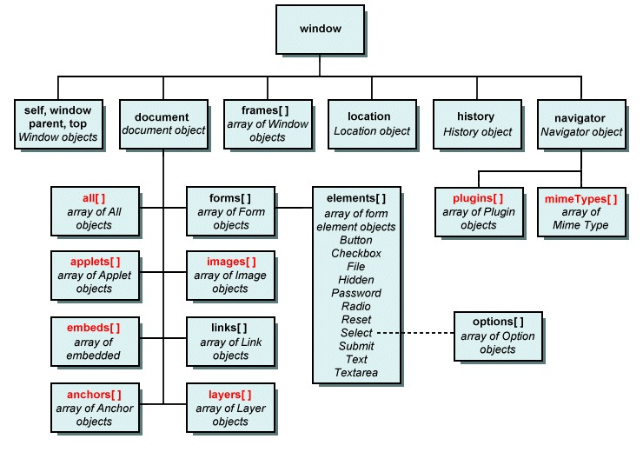
Browser hierarchy

Slide 49
Document Object Model (DOM)
The HTML DOM is a standard for how to get, change, add, or delete HTML elements.
DOM Nodes - According to the W3C HTML DOM standard, everything in an HTML document is a node:
The entire document is a document node
Every HTML element is an element node
The text inside HTML elements are text nodes
Every HTML attribute is an attribute node
Comments are comment nodes

Slide 50

DOM Tree

Slide 51
Document Object
When an HTML document is loaded into a web browser, it becomes a document object.
The document object is the root node of the HTML document.
The document object is a property of the window object.

Slide 52
Document Object
The getElementById() Method
The getElementById() method returns the element with the specified ID:
Example
<html>
<body>
<p id="intro">Hello World!</p>
<p>This example demonstrates the <b>getElementById</b> method!</p>
<script>
x=document.getElementById("intro");
document.write("<p>The text from the intro paragraph: " +
x.innerHTML + "</p>");
</script>
</body>
</html>

Slide 53
Document Object
Method | Description
getElementById() | Returns the element that has an ID attribute with the a value
getElementsByTagName() | Returns a node list (collection/array of nodes) containing all elements with a specified tag name
getElementsByClassName() | Returns a node list containing all elements with a specified class
query Selector() | Returns the first element that matches a specified CSS selector(s) in the document
query SelectorAll() | Returns a static NodeList containing all elements that matches a specified CSS selector(s) in the document

Slide 54
Document Object
Changing HTML Content
document.getElementById(id).innerHTML = new HTML
const element = document.getElementById("id"); element.innerHTML = "New Heading";
Changing Attribute Value
document.getElementById(id).attribute = new value
document.getElementById(“anc").href = “vit.ac.in";
Changing HTML Style
document.getElementById(id).style.property = new style
document.getElementById("p2").style.color = "blue";

Slide 55
HTML DOM Events
A JavaScript can be executed when an event occurs, like when a user clicks on an HTML element.
OnClick
OnMouseOver
OnFocus
OnLoad
OnSubmit
OnChange

Slide 56
String Object & Methods
Can be created using a string literal or constructor
Methods
charAt(index)
Returns char at specified index
indexOf(searchstring [, index]);
Returns index of first char,else returns -1
lastIndexOf(searchstring [, index]); //starting from index
Searches backwards for last occurence
name = “VIT university”;
school=new String (“SITE”);

Slide 57
String Object & Methods
Methods
replace(exp [, replacement text]);
Search(expression)
Split(delimiter[,count]); // an array of substring
Substr(start[,length]) ;
toUpperCase()
toLowerCase();
name = “Hello World”;
message=name.replace(/World/,”VIT”); // Hello VIT
name = “Hello VIT”;
message=name.split(“ ”); // Hello, VIT
name = “Hello VIT”;
message=name.toLowerCase();

Slide 58
Array Object & Methods
Methods | Description
concat() | Joins two or more arrays, and returns a copy of the joined arrays
indexOf() | Search the array for an element and returns its position
join() | Joins all elements of an array into a string
lastIndexOf() | Search the array for an element, starting at the end, and returns its position
pop() | Removes the last element of an array, and returns that element
push() | Adds new elements to the end of an array, and returns the new length
reverse() | Reverses the order of the elements in an array
shift() | Removes the first element of an array, and returns that element
slice() | Selects a part of an array, and returns the new array
sort() | Sorts the elements of an array
splice() | Adds/Removes elements from an array
toString() | Converts an array to a string, and returns the result
unshift() | Adds new elements to the beginning of an array, and returns the new length
valueOf() | Returns the primitive value of an array

Slide 59
Math Object & Methods
Methods | Description
abs(x) | Returns the absolute value of x
ceil(x) | Returns x, rounded upwards to the nearest integer
cos(x) | Returns the cosine of x (x is in radians)
exp(x) | Returns the value of E^{x}
floor(x) | Returns x, rounded downwards to the nearest integer
log(x) | Returns the natural logarithm (base E) of x
max(x,y,z,...,n) | Returns the number with the highest value
min(x,y,z,...,n) | Returns the number with the lowest value
pow(x,y) | Returns the value of x to the power of y
random() | Returns a random number between 0 and 1
round(x) | Rounds x to the nearest integer
sin(x) | Returns the sine of x (x is in radians)
sqrt(x) | Returns the square root of x
tan(x) | Returns the tangent of an angle

Slide 60
Date Object
The Date object is used to work with dates and times.
Date objects are created with the Date() constructor.
new Date() // current date and time new Date(milliseconds) //milliseconds since 1970/01/01 new Date(yy,mm,dd) //with specified date new Date(yy,mm,dd,hh,mm,ss) //with specified date & time new Date(“Month dd,yyyy”) //datestring in the given format new Date(“Month dd,yyyy hh:mm:ss”) //datestring in the //given format
var today = new Date() var d1 = new Date("October 13, 1975 11:13:00") var d2 = new Date(13,5,24) var d3 = new Date(13,5,24,11,33,0)

Slide 61
Date Object-Methods
getFullYear() //4-digit year
getMonth() //(0-11 as Jan=0,feb=1…)
getDate() //(1-31)
getDay() //(0-6 as Sunday=0)
getHours //(0-23)
getMinutes //(0-59)
getSeconds //(0-59)
getMilliseconds //(0-999)
getTimezoneOffset //time diff between local PC and GMT

Slide 62
Current date and time
<script>
var currentDate = new Date()
var day = currentDate.getDate();
var month = currentDate.getMonth() + 1;
var year = currentDate.getFullYear();
var my_date = day+"-"+month+"-"+year;
document.write("Todays date is : "+my_date);
var hours = currentDate.getHours()
var minutes = currentDate.getMinutes()
if (minutes < 10){
minutes = "0" + minutes
}
document.write(hours + ":" + minutes + " ")
if(hours > 11){
document.write("PM")
} else {
document.write("AM")
}
</script>

Slide 63
Number Object & Methods
Property | Description
MAX_VALUE | Returns the largest number possible in JavaScript
MIN_VALUE | Returns the smallest number possible in JavaScript
NEGATIVE_INFINITY | Represents negative infinity (returned on overflow)
NaN | Represents a "Not-a-Number" value
POSITIVE_INFINITY | Represents infinity (returned on overflow)

Slide 64
Number Object & Methods
Methods | Description
toExponential(x) | Converts a number into an exponential notation
toFixed(x) | Formats a number with x numbers of digits after the decimal point
toPrecision(x) | Formats a number to x length
toString() | Converts a Number object to a string

Slide 65
Global Properties and methods
Global properties and functions can be used with all the built-in JavaScript objects.
Property | Description
Infinity | A numeric value that represents positive/negative infinity
NaN | "Not-a-Number" value
undefined | Indicates that a variable has not been assigned a value

Slide 66
Global Methods
Methods | Description
decodeURI() | Decodes a URI
decodeURIComponent() | Decodes a URI component
encodeURI() | Encodes a URI
encodeURIComponent() | Encodes a URI component
escape() | Deprecated in version 1.5. Use encodeURI()or encodeURIComponent()instead
eval() | Evaluates a string and executes it as if it was script code
isFinite() | Determines whether a value is a finite, legal number
isNaN() | Determines whether a value is an illegal number
Number() | Converts an object's value to a number
parseFloat() | Parses a string and returns a floating point number
parseInt() | Parses a string and returns an integer
String() | Converts an object's value to a string
unescape() | Deprecated in version 1.5. Use decodeURI()or decodeURIComponent() instead

Slide 67
Window Object
It represents the browser ‘s window
All javascript objects ,functions and variables are members of window object
Document object is property of window object
Properties | Description
innerHeight | Inner height of the browser window
innerWidth | Inner width of the browser window
defaultStatus | Default message displayed in browser status bar
Document | Current document displayed in the window
Frames | Array of frames of the current window
Length | Number of frames in the current window
Name | Name of the window
Opener | Reference to the window that opened this window
Closed | Indicates whether window is closed or not(true or false)
Self | Reference to cuurent window
Status | Specifies a temp message to display in status bar

Slide 68
Window Object
Methods | Description
Open() | Open a new window
Close() | Close the current window
moveTo(left,top) | Move the current window
resizeTo() | Resize the current window
Alert | Pop ups alert dialog box
Confirm | Pop ups confirm box
Prompt | Pop ups prompt box
moveBy(x,y) | Changes position of window by specified pixels
Print() | Prints the contents of the window
setInterval,clear Interval
setTimeout, clearTimeout
Stop | Stops the loading of current page

Slide 69
Screen Object
It represents the user’s screen
Usage : screen.availWidth - returns in pixels
Properties | Description
availHeight | Available screen height
availWidth | Available screen width

Slide 70
Location Object
It represents the current page address
Properties | Description
Hostname | Domain name of the web host
Pathname | Path and filename of the current page
Port | Port of the web page
Protocol | Returns the web protocol used
Href | Returns the URL of the current page
Methods
Replace(URL) | Replaces the current URL
Reload() | Reload the current URL

Slide 71
History Object
It represents the browser ‘s history
Properties | Description
Length | Number of entries in history object
Methods | Description
Back() | Previous URL in the history list
Forward() | Next URL in the history list
Go(relPos|String) | Loads specific URL in the list specified by relative position from the current position or by the URL

Slide 72
Navigator Object
It contains the browser information
Properties | Description
appcodeName | Code name of the browser
appName | Name of the browser
cpuClass | Type of CPU
Platform | OS
Plugins | Array of plugins installed in the browser
appVersion | Version of the browser
userAgent | Detailed info about the browser
cookieEnabled | Whether cookie is enabled or not(true or false)

Slide 73
Form Validation
Client side form validation usually done with javascript.
Form data that typically are checked by a JavaScript could be:
Required fields
Valid user name
Valid password
Valid email address
Valid phone number

